Slide 1
Vulcan Activity Tracker
CMSC-4920-Senior Project 2
Group2
Team: Margo Bonal, John Gerega, Luke Ruffing

Slide 2
Weekly Progress
Progress
Challenges
Too many different fields per sport to hard-code the JavaScript to look for to pull data
Storing specific activity data in database
Complex Schema per data type
Username Per session:
Personalize charts
Username is unique database key for cross references
Database Race Condition
Formatting Laptop vs PC Monitor
Dom not registering API quick enough
Charts not rendering upon submit data, needs fixed still
Goal 1 – user-friendly activity page
Goal 2 – uploading activities into the database
Goal 3 – display uploaded activities on the activity page

Slide 3
Solutions
Program receives data from the frontend
Backend gets common details first, then sports-specific information
Injects the data into the database
Implement Local Storage feature to store username for session
Change DOM functions to use async to wait for data
Store all activity data as an list -> {}, then parse list for specific field

Slide 4
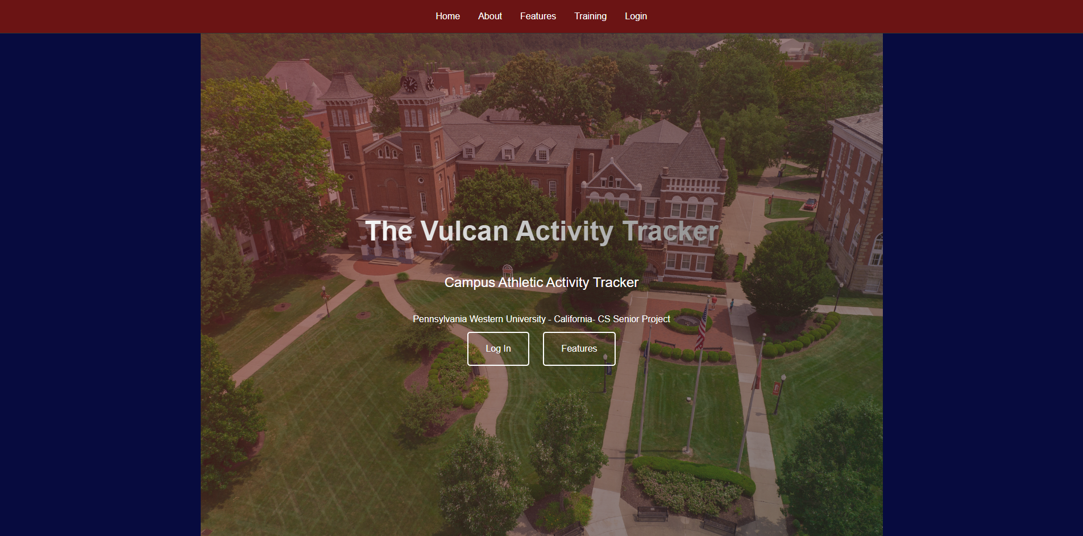
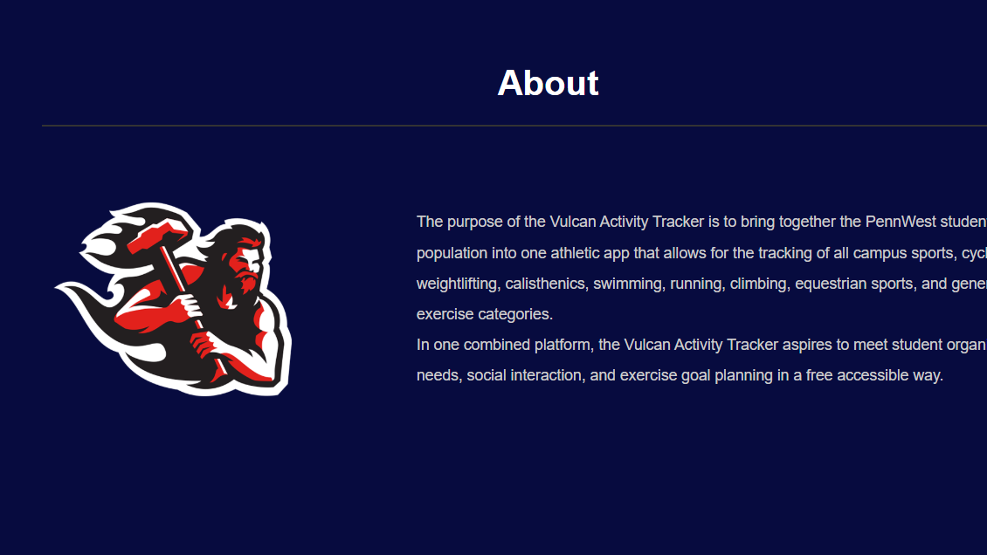
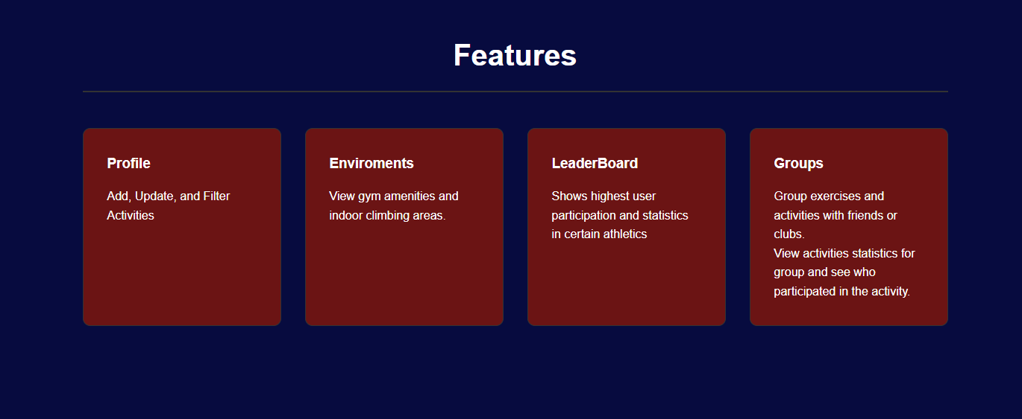
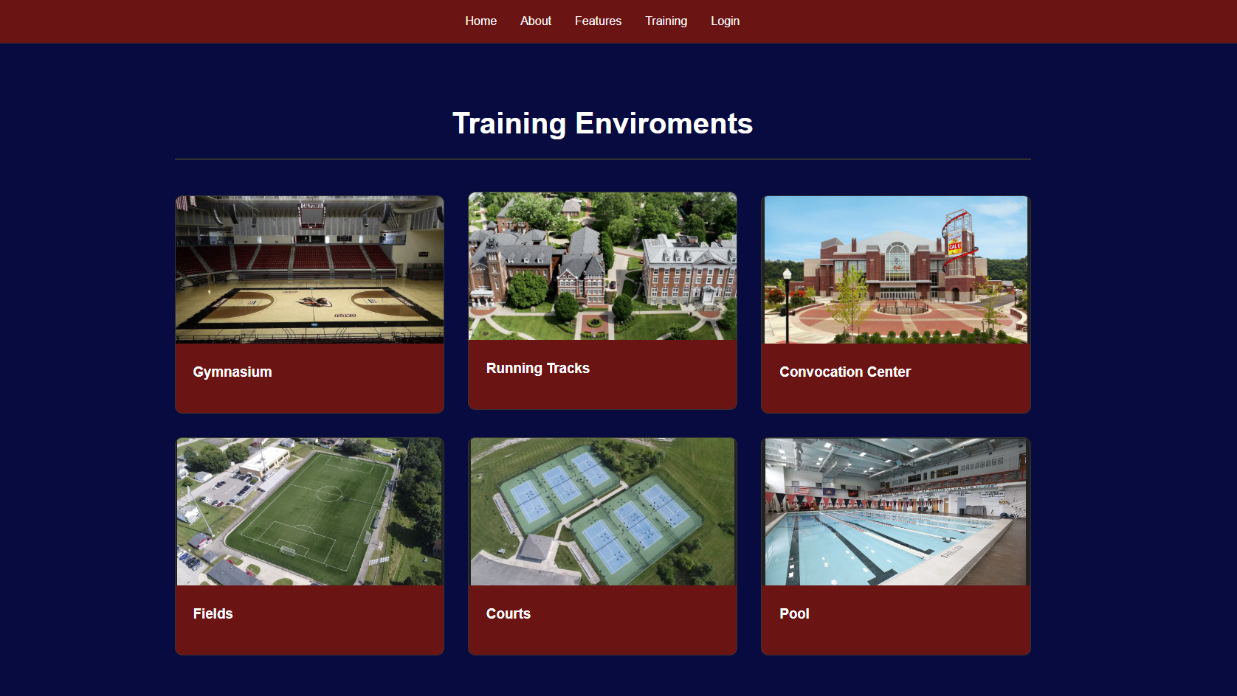

Slide 5
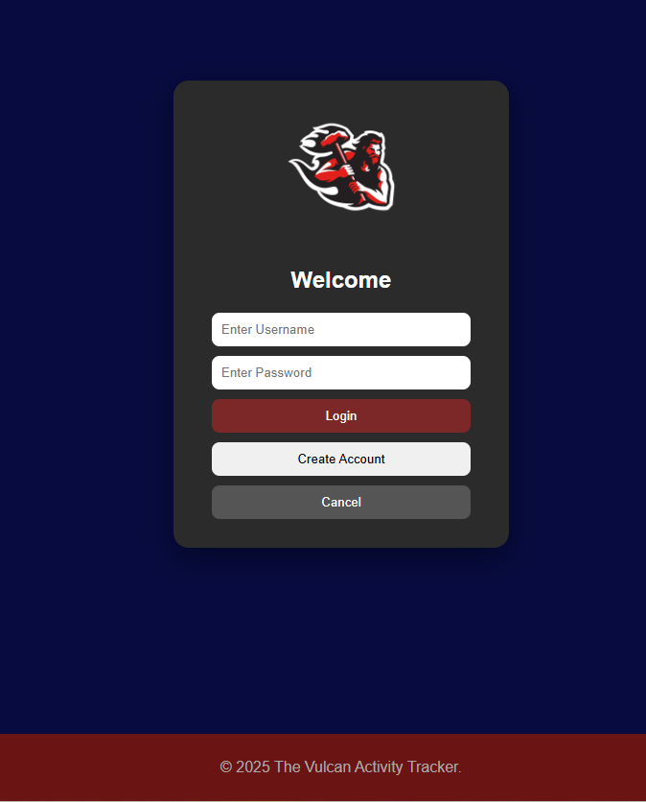
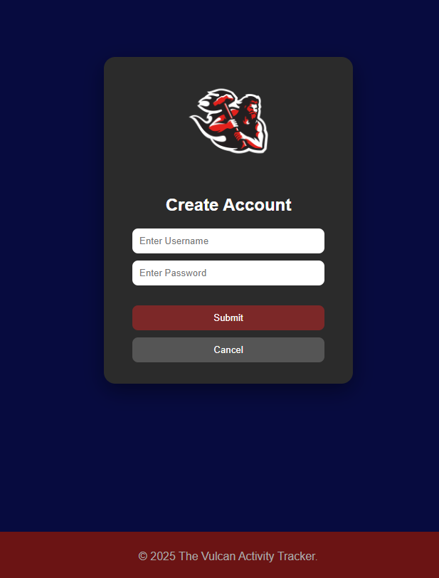
User Account Portal

Slide 6
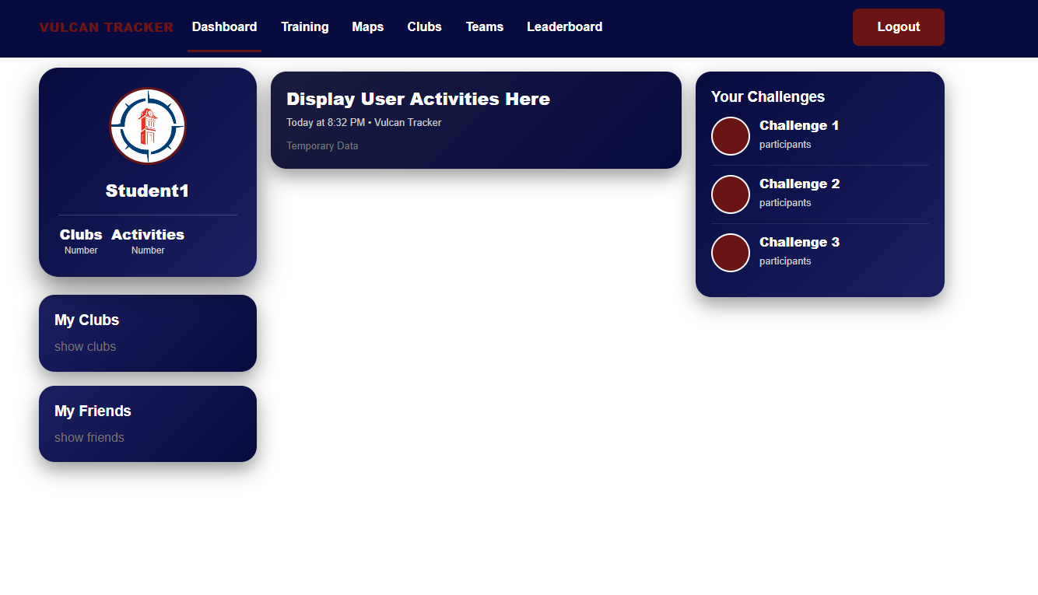
Dashboard

Slide 7
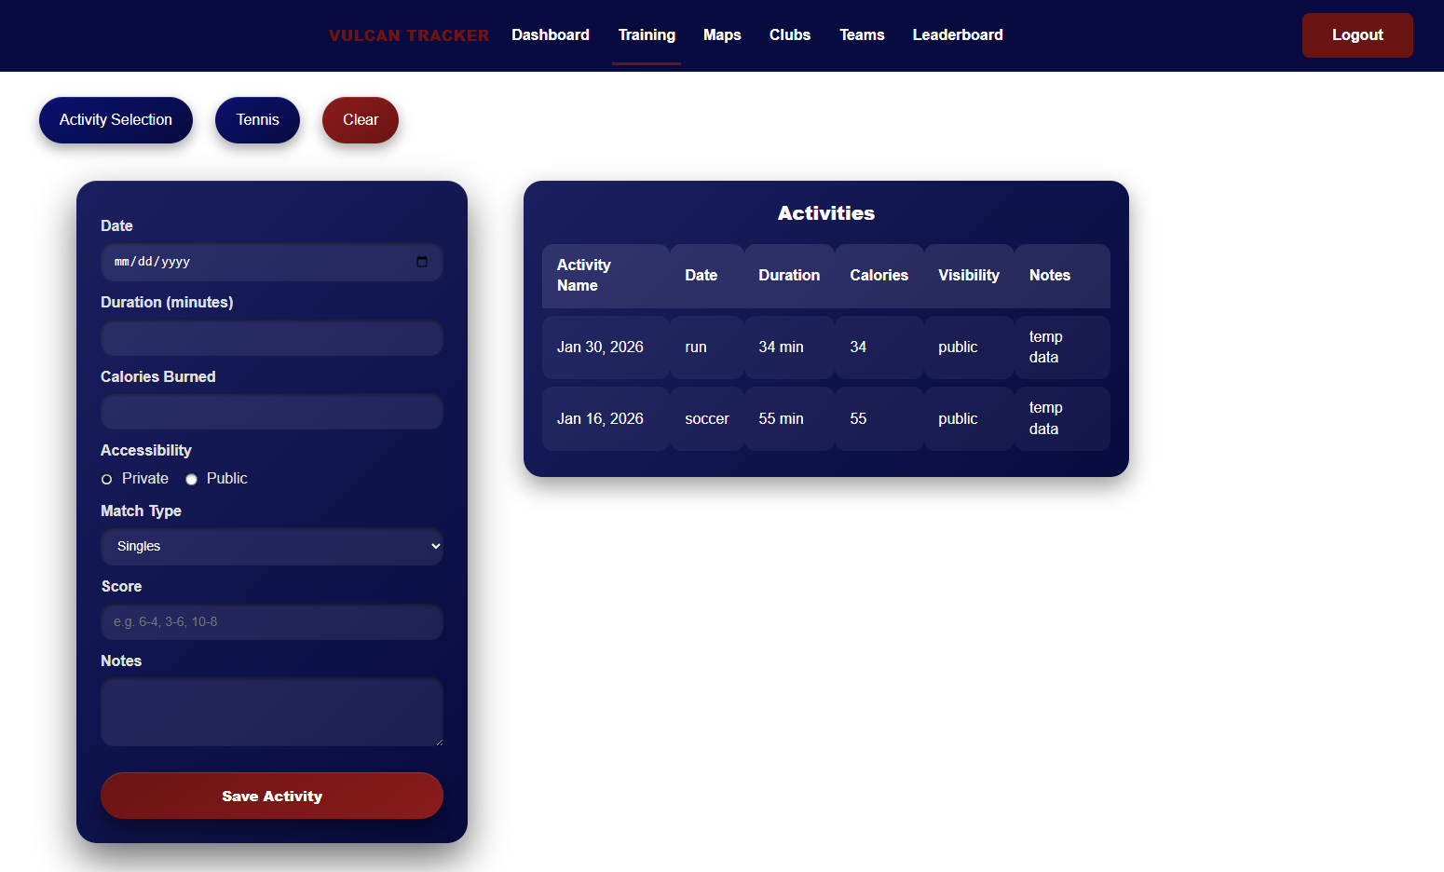
Activity Page

